Slide 1
Show, Control and Tell: A Framework for Generating Controllable and Grounded Captions
2019 cvpr

Slide 2
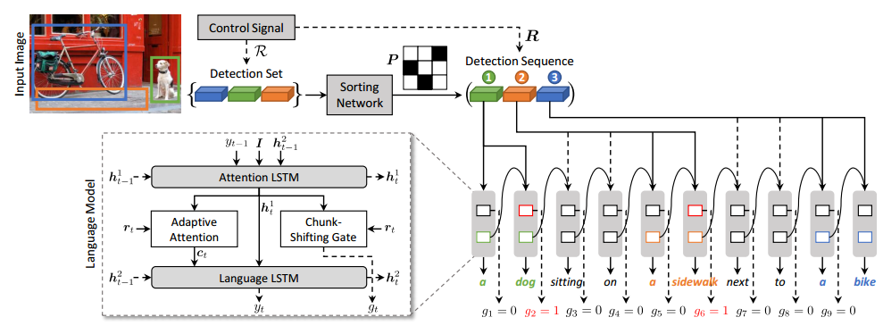
architecture

Slide 3
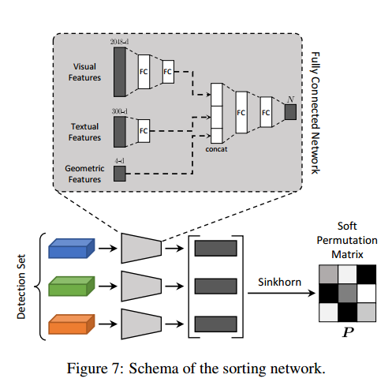
Sorting network

